Slide 1
threading
By :
Sarang Shisode

Slide 2
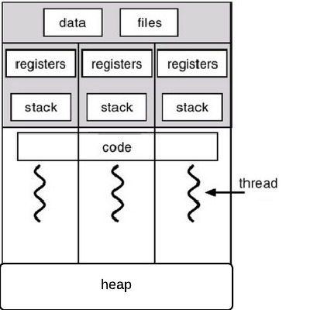
Process & threads
Process : Program in
Execution
Thread : Smallest Unit to
which OS allocates
Processor
C# : System.Threading

Slide 3
Where do we need threads?
FOREGROUND AND BACKGROUND PROCESSES
ASYNCHRONOUS PROCESSING
MULTI USER SYSTEM
SERVER

Slide 4
Why?
MORE RESPONSIVE
LOW COST
EASY TO BUILD SCALABLE APPLICATIONS
CLEANER AND ELEGANT PROGRAM DESIGN
SPEEDY EXECUTION.

Slide 5
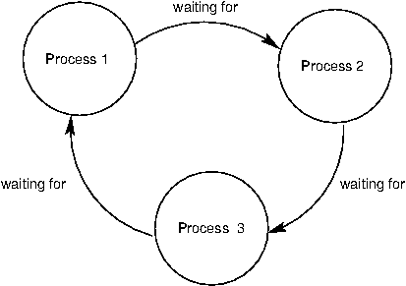
ISSUES
DEGRADE PERFORMANCE
RACE CONDITION
DEADLOCK
NO SEQUENCE GAURANTEE

Slide 6
ACCESSING SHARED RESOURCE
LOCK
MONITOR
MUTEX
SEMAPHORE

Slide 7
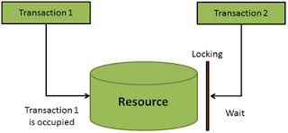
Lock and monitor
Disadvantages:
DEADLOCK
2. DEGRADE PERFORMANCE

Slide 8
Mutex and SEMAPHORE
MUTEX:
Inter Process synchronization.
Interop Transition.
SEMAPHORE:
Used for CPU intensive applications.

Slide 9
THANK YOU!

